Slide 1

ONLINE SHOPPER’S PURCHASE INTENTION

Slide 2
TEAM PEERLESS
-Nimith Narapareddy (U64915972)
-Mani Sai .P (U20468035)
-Manohar Reddy Pasham (U51001133)
-Nandini Bethamcharla (U35263346)
-Lakshmi Lavanya Javvadi (U85351468)

Slide 3
Introduction
The e-commerce industry is expected to grow by almost $11 trillion between 2021 and 2025. As businesses came online during the COVID-19 pandemic, the global trend toward digitization surged ahead at lightning speed. Even as regions begin to reopen, e-commerce growth keeps climbing. Global e-commerce sales are expected to reach $5 trillion in 2022, and $6 trillion by 2024.
Merchants continue to follow consumer demand online, flocking to ecommerce in record numbers. Online stores are popping up daily, with an estimated 12–24 million ecommerce sites across the globe. This ecommerce growth means more brands competing for customers.

Slide 4
Business Problem
-Can we predict if a visitor/customer will make a purchase or not based on their website activity?

Slide 5
Solution
For any E-commerce Company. It is essential to build a model that can predict whether a customer will generate Revenue. (through purchase of their products/services)
We as a team aim to use the information customers may leave in the form of a trace of browsing history data or user information when they visit an online shopping site. With the help of this information, build a project aims to predict online shoppers' purchasing intention by using clickstream and session information data.
Moreover, the main objective of the project is to build Predictive model that can predict customer purchase intention as accurately as possible.

Slide 6
About the data
Data Collection:
Google Analytics data of various Turkish Websites collected during the time period of 2017-2018
Source:
https://archive.ics.uci.edu/ml/datasets/Online+Shoppers+Purchasing+Intention+Dataset
Dataset description:
The dataset consists of 10 numerical and 8 categorical attributes.
Rows : 12330 , Columns : 18
Description
Data Set Characteristics: | Multivariate | Number of Instances: | 12330
Attribute Characteristics: | Integer, Real | Number of Attributes: | 18

Slide 7

More About The Dataset
Pages Visited
(float64)
Administrative
Informational
ProductRelated
Page Duration
(float64)
Administrative_Duration
Informational_Duration
ProductRelated_Duration
Visitor Type
(object)
New_visitor
Returning_visitor
Others
Behavior
Google Analytics Metric
BounceRate (float64)
ExitRate (float64)
PageValues (float64)
SpecialDay (float64)
Month (object)
JAN to DEC
Weekend (bool)
TRUE or FALSE
Campaign
Region (int64)
1 to 9
TrafficType
(int64)
1 to 20
Geo
Target Variable – REVENUE (bool)
Browser
(int64)
1 to 13
OperatingSystems
(int64)
1 to 8
Technology
7

Slide 8
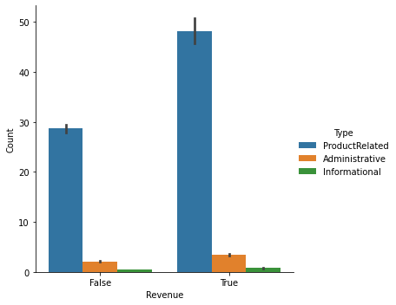
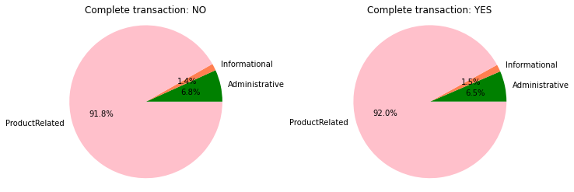
Exploratory Data Analysis
More customers viewed web pages related to products than administrative or informational pages.
At this stage of the visual EDA, it appears to be obvious that the admin page is the HOME page, the informational page is CONTACT US #, and the product-related page is the one for the particular product of interest.
Administrative, informational, and product pages visited: percentages of related websites visited
It's evident why more people visit product-related pages than administrative or informational pages—they're there to make a purchase, not just to read.

Slide 9
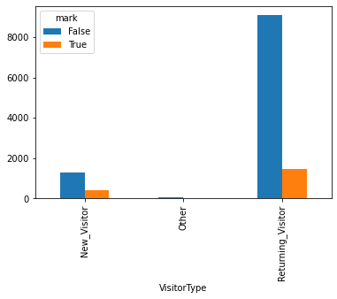
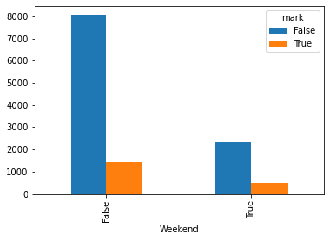
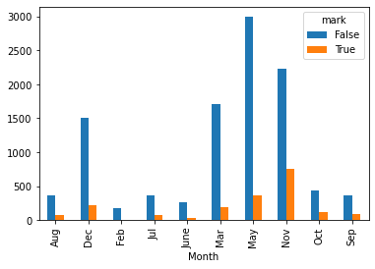
Exploratory Data Analysis
Revenue vs VisitorType
The majority of website visitors are returning consumers, who also make the majority of transactions.
Compared to 15% of returning visitors, only around one-fourth of new visitors completed a purchase.
Month vs Revenue
The website received the majority of its traffic in the months of May and November, when the conversion to revenue ratios were remarkably similar.
The month of November saw the greatest amount of purchases, while February saw the fewest visits from customers and the smallest number of purchases overall.
Weekend vs Revenue
The chart below shows that although while there are more visits throughout the week than on weekends, there is no appreciable variation in the rates at which those visitors become customers.

Slide 10
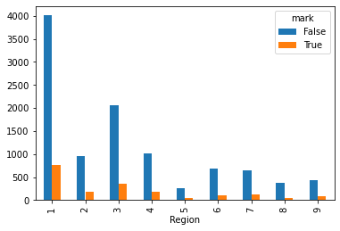
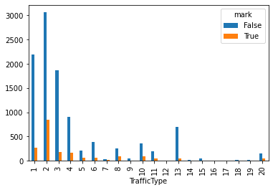
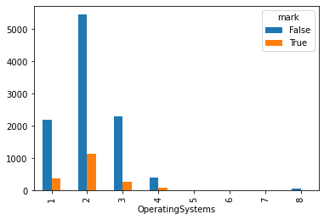
Exploratory Data Analysis
Region vs Revenue
Region 1 generates the most revenue, followed by Region 3, and Region 5 and Region 8 contribute very little to revenue.
TrafficType vs Revenue
Traffic type 2 generates the most revenue, followed by traffic types 1 and 3. Traffic types 14 and 20 contribute relatively little to revenue.
OS vs Revenue
People using OS type 2 generate majority of revenue.

Slide 11
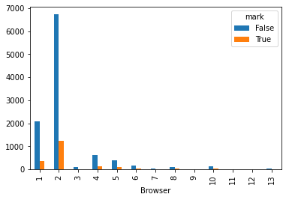
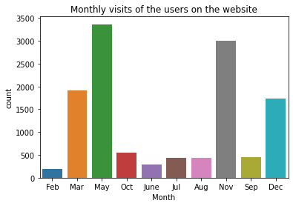
Exploratory Data Analysis
Browser vs Revenue
Browsers 2 and 1 provide the majority of revenue. Browsers 3, 9, 11, 12, and 13 did not contribute.
Visits to the website on each month
The months May and November saw the most traffic to the website.

Slide 12
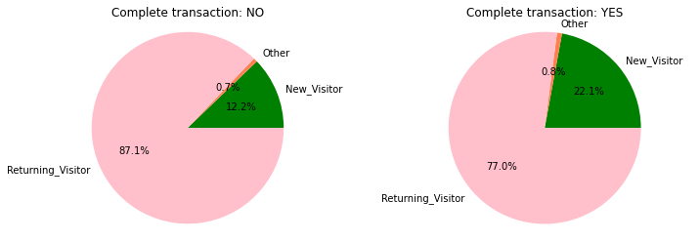
Exploratory Data Analysis
The percentage of first-time visitors who make a purchase is higher,
Even if there are more repeat customers among those who abandon their shopping carts.

Slide 13
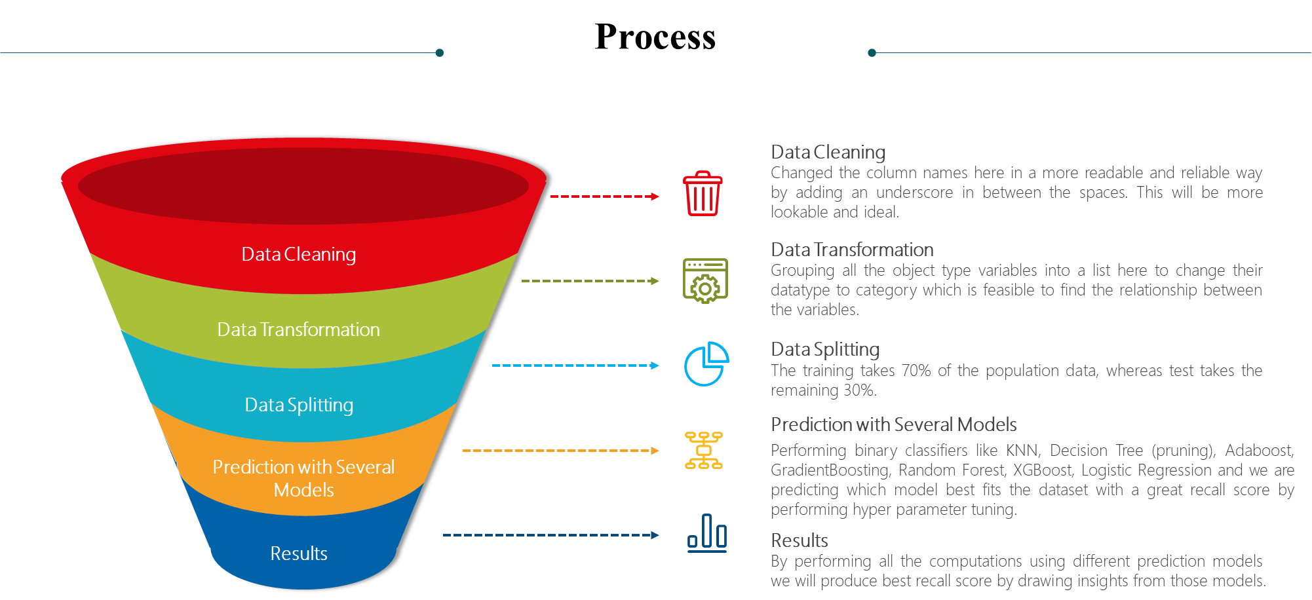
Process

Slide 14
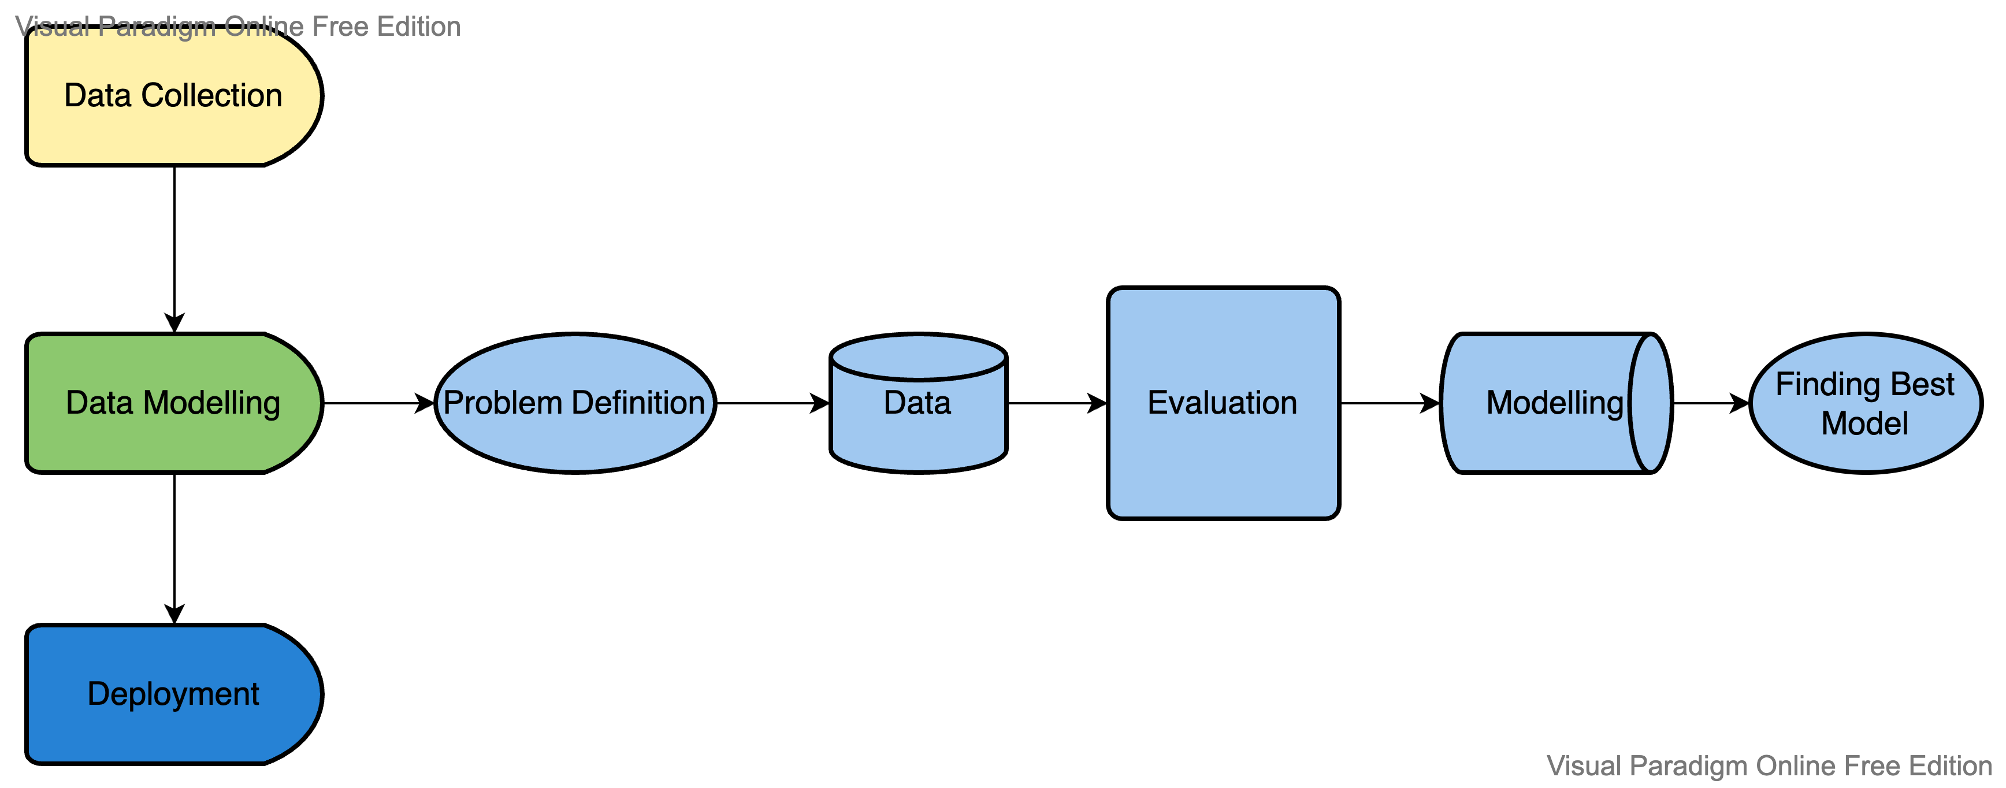
Approach

Slide 15
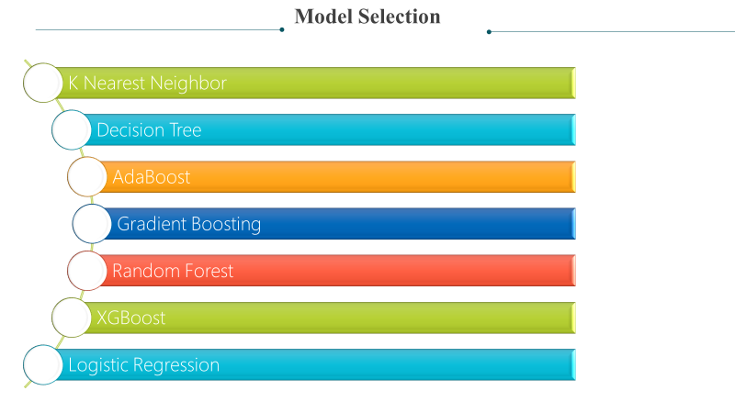
Model Selection

Slide 16
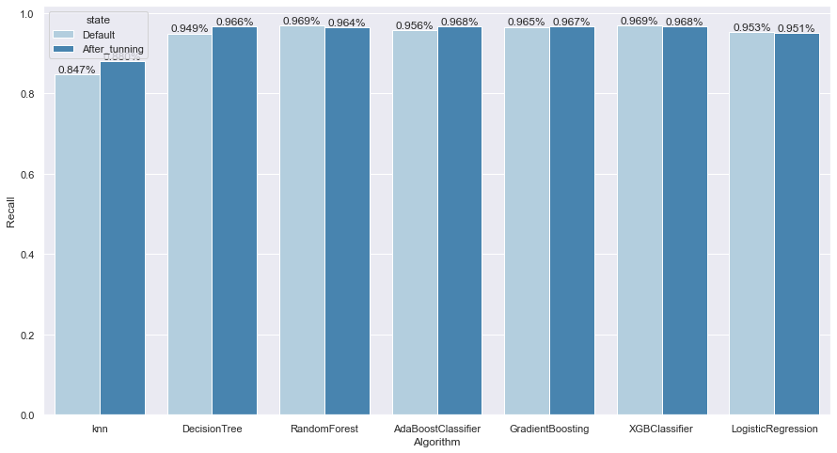
Result

Slide 17

Conclusion
For this dataset, XGBoost is the best fit model with learning_rate at 0.1, max_depth is 3 and estimators as 100. With highest recall score of 96%.
From feature selection and modelling: the most important features from the data are - PageValues, ProductRelated_Duration, Month, ExitRates, , Administrative, VisitorType, Weekend, SpecialDay.
Looking at our results, the company should focus on improving the mobility between pages a encourage users to browse different products as page value was one of the most characteristics that are important in determining whether a purchase would be made.
Some months like May and November have had a higher frequency of purchases, that is e-commerce businesses are expected to capitalize on these months and provide additional sales and offers stimulate product sales.

Slide 18
Suggestions
Identify web data and metrics to focus on to help e-commerce businesses understand online shopping behavior so they can configure their websites and Google Analytics associated accordingly.
Since our model is able to predict users who buy and the best months to buy, it can help companies formulate elements such as targeted ads, offers and programs, etc.
This can be a great model for online apparel companies where most users shop in storefront instead of actually buying.
This can be applied to the regular online purchase of books, household items, electronics, cameras, cell phones, etc.

Slide 19


